Slide 1


Chippy quest
Archie Tippett

Slide 2

Design & Planning
Basement
Sewers
Chippy
Super secret basement
Home
Village
Co-op
Warehouse
Highway
Backdoor

Slide 3
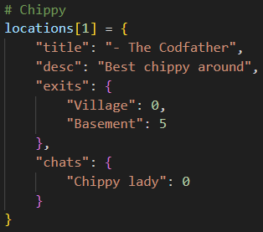
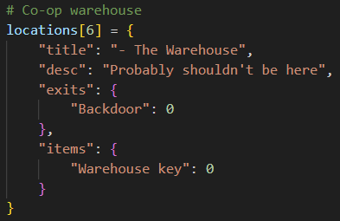
Locations - Dictionaries
Each location has its’ own dictionary that can be called via its’ number, as well as all relevant information

Slide 4
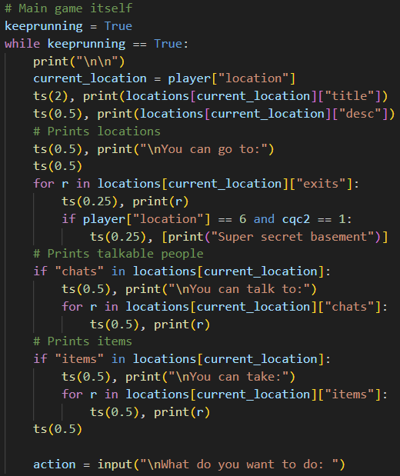
The main game – how it runs
- The entire game runs as a while loop, so every time a new location is entered, the loop resets and prints different variables.
For example, here the program cycles through the ‘exits’ index and prints each one.
- Same concept for talk & take.

Slide 5
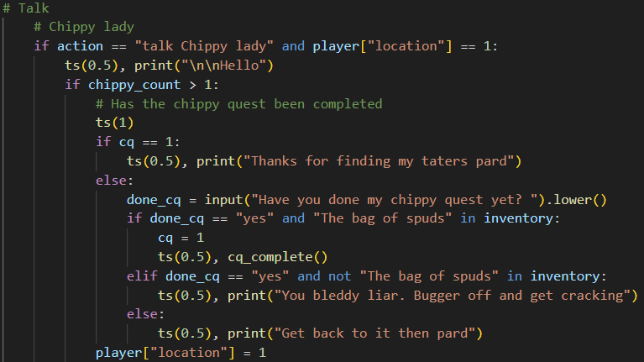

Dialogue
The program uses variables that confirm whether items have been picked up / quests have been completed to print different dialogues.

Slide 6
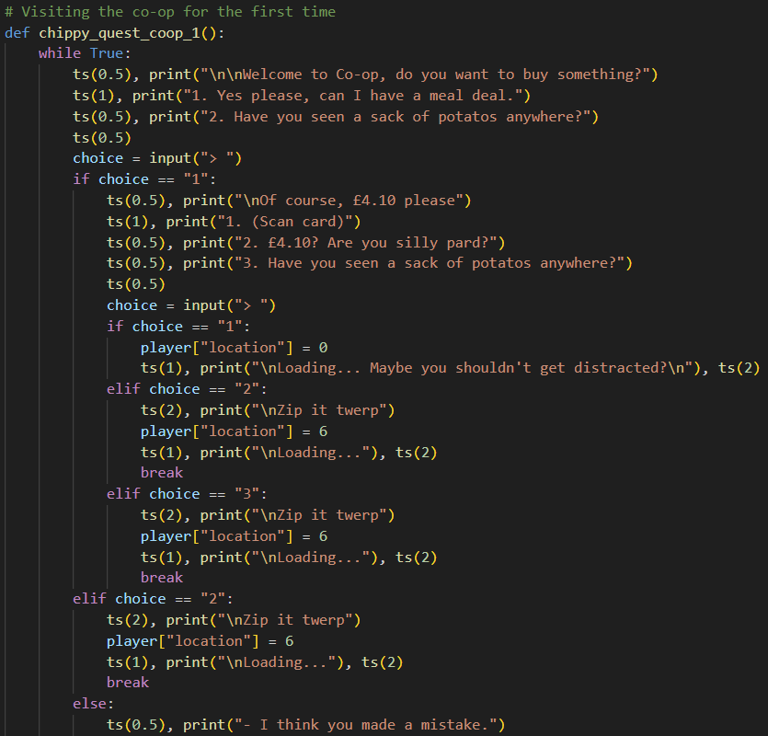
Further dialogue
Different outcomes depending on input.

Slide 7
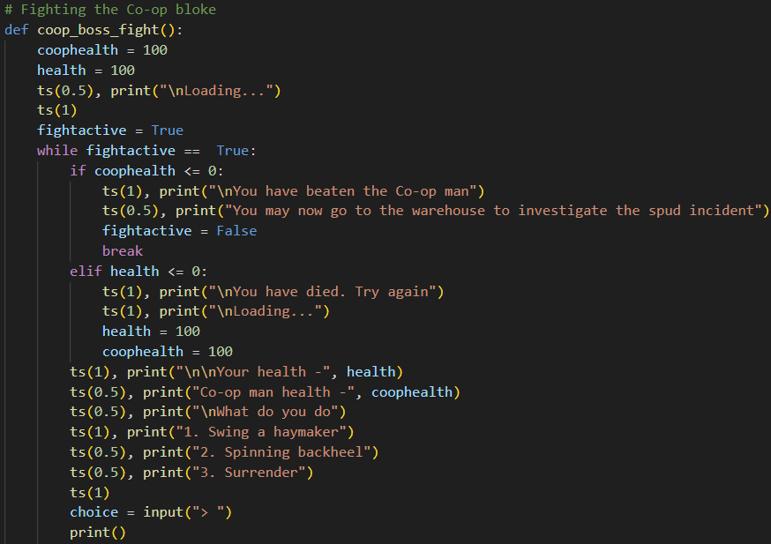
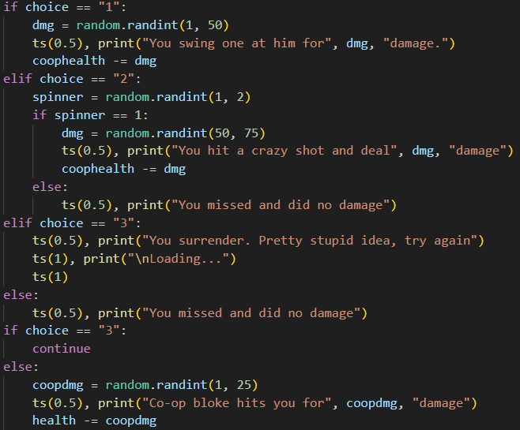
Fight
Utilises the random.randint command to deal random amounts of damage.
- Also contains failsafes for if an input is invalid.

Slide 8
